Slide 1
Haystack Design Review Round 2
Notes:
Design review 2
CHP Compiler
Now named haystack

Slide 2
Project Goals
Introduction ●◌◌◌ | State Space ◌◌◌ | State Variables ◌◌◌◌◌◌◌◌ | Problems ◌◌
Automate Martin Synthesis
Haystack: A Compiler for CHP | Ned Bingham
Notes:
Blunt
One goal
Automate Martin Synthesis
Produces good results
Complex
Not well specified

Slide 3
Known Issues
Introduction ◌●◌◌ | State Space ◌◌◌ | State Variables ◌◌◌◌◌◌◌◌ | Problems ◌◌
Slow and untested for large systems
Unnecessary state variables
Overly explicit environments
Long production rules
Unstable guards not supported
Reset not enforced in PRs
Not bubble/handshake reshuffled
Haystack: A Compiler for CHP | Ned Bingham
Notes:
Known issues
Taking strides to fix
Slow
threading
optimization
Unnecessary state variables
better grouping algorithm
Conflict not solved
don’t yet know
Overly explicit environments
state space level simplification technique
Long production rules
operator reduction
handshake reshuffling

Slide 4
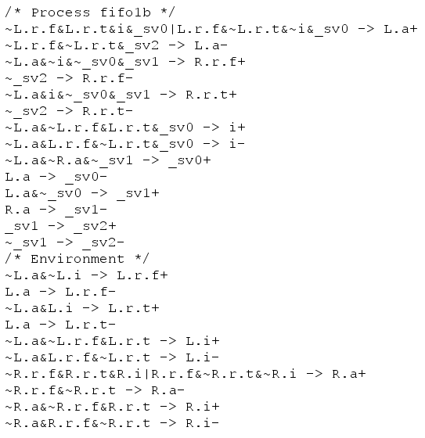
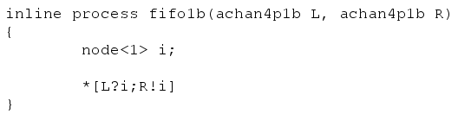
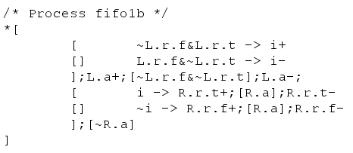
Results: One Bit FIFO
Introduction ◌◌●◌ | State Space ◌◌◌ | State Variables ◌◌◌◌◌◌◌◌ | Problems ◌◌
Haystack: A Compiler for CHP | Ned Bingham

Slide 5
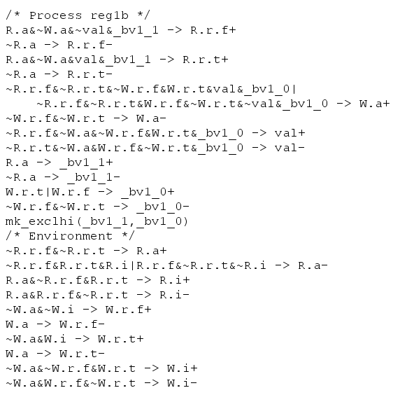
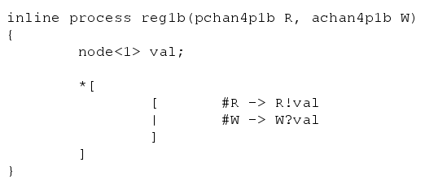
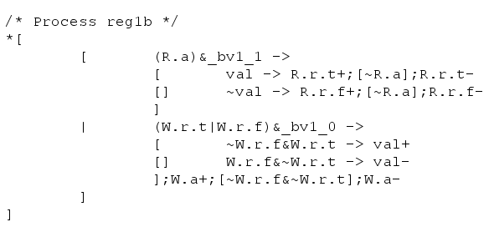
Results: One Bit Register
Introduction ◌◌◌● | State Space ◌◌◌ | State Variables ◌◌◌◌◌◌◌◌ | Problems ◌◌
Haystack: A Compiler for CHP | Ned Bingham

Slide 6
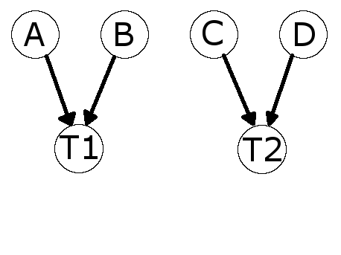
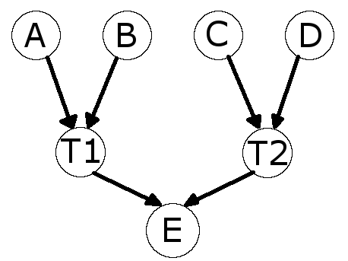
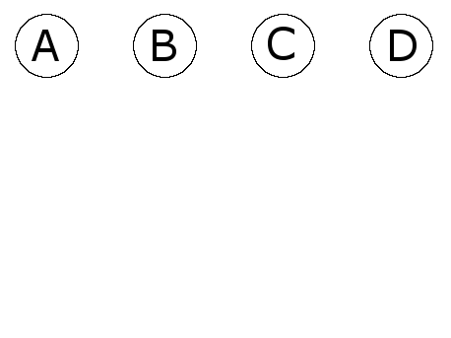
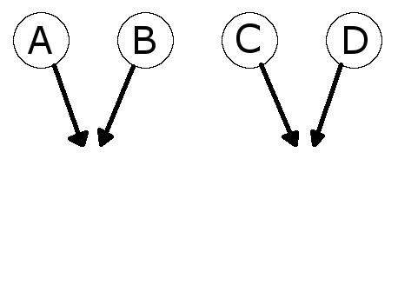
State Space Elaboration Overview
Introduction ◌◌◌◌ | State Space ●◌◌ | State Variables ◌◌◌◌◌◌◌◌ | Problems ◌◌
AND implicant states
Apply transitions
OR Results
Smooth mutables
Apply production rules
Execute debug functions
Haystack: A Compiler for CHP | Ned Bingham

Slide 7
Mutables
Introduction ◌◌◌◌ | State Space ◌●◌ | State Variables ◌◌◌◌◌◌◌◌ | Problems ◌◌
Active transition on a channel variable
r+;[a];r-;[~a]
Parallel transitions
a+; b+; c+; [d]; (c-;b- || b-;a-); [~d]
Intra process communication
a+; b+; [d]; (c-;C!;a- || b-;C?;c+); [~d]
Haystack: A Compiler for CHP | Ned Bingham

Slide 8
Mutables
Introduction ◌◌◌◌ | State Space ◌●◌ | State Variables ◌◌◌◌◌◌◌◌ | Problems ◌◌
Isochronic Forks
[ i -> r.t+[] ~i -> r.f+]; [a];
(
); [~a]
assume{a};
r.t- ||
assume{a};
r.f-
Haystack: A Compiler for CHP | Ned Bingham

Slide 9
Mutables
Introduction ◌◌◌◌ | State Space ◌●◌ | State Variables ◌◌◌◌◌◌◌◌ | Problems ◌◌
Define “mutable” as a {variable, value} pair
Give each state a list of mutables
For an active transition on a channel variable
Add {v, X} for all passive variables in that channel
For Transition T in parallel with state S
Add {v, T(v)} for all variables in T
If state S conflicts with {var, val}, smooth var out of S
Haystack: A Compiler for CHP | Ned Bingham

Slide 10
Production Rules
Introduction ◌◌◌◌ | State Space ◌◌● | State Variables ◌◌◌◌◌◌◌◌ | Problems ◌◌
Branch variables
Future “prs” block
Need to elaborate their values in the state space
No need to add new states (we already have the production rules)
Order does not matter (aside from mk_exclhi)
Cycles are possible (need to find invariant)
Haystack: A Compiler for CHP | Ned Bingham

Slide 11
Production Rules
Introduction ◌◌◌◌ | State Space ◌◌● | State Variables ◌◌◌◌◌◌◌◌ | Problems ◌◌
Given state E with state encodings (minterms) {E₁, E₂, …, E_{n}} and the set of production rules {G₁ -> T₁, G₂ -> T₂, …, G_{n} -> T_{n}}
Gather all production rules enabled by E_{i}
Create multiple groups to handle mk_exclhi
Remove conflicting production rules
AND the transitions together
Apply resulting transition
Recurse until cycle found or no production rule enabled
Haystack: A Compiler for CHP | Ned Bingham

Slide 12
State Variable Insertion Overview
Introduction ◌◌◌◌ | State Space ◌◌◌ | State Variables ●◌◌◌◌◌◌◌ | Problems ◌◌
Identify tails
Identify conflicts
Group conflicts
Generate paths
Trim paths
Consider Indistinguishables
Place state variable transitions
Haystack: A Compiler for CHP | Ned Bingham

Slide 13
The Tail
Introduction ◌◌◌◌ | State Space ◌◌◌ | State Variables ◌●◌◌◌◌◌◌ | Problems ◌◌
Given T1;T2 such that A → T1 → B → T2, and T1 is either an assignment that might be vacuous, or a guard
B is always indistinguishable from A
If T2 fires at A, T1 has already happened
A is then considered to be in the tail of B
Haystack: A Compiler for CHP | Ned Bingham

Slide 14
Conflict Identification
Introduction ◌◌◌◌ | State Space ◌◌◌ | State Variables ◌◌●◌◌◌◌◌ | Problems ◌◌
State A with transition T conflicts with state B if:
T is active (i.e. an assignment, not a guard)
A and B are not the same state
B is not in the tail of A
T changes the information we know in B (i.e. not vacuous)
A and B are not parallel siblings
Having smoothed the variables of T out of A, A is indistinguishable from B
Haystack: A Compiler for CHP | Ned Bingham

Slide 15
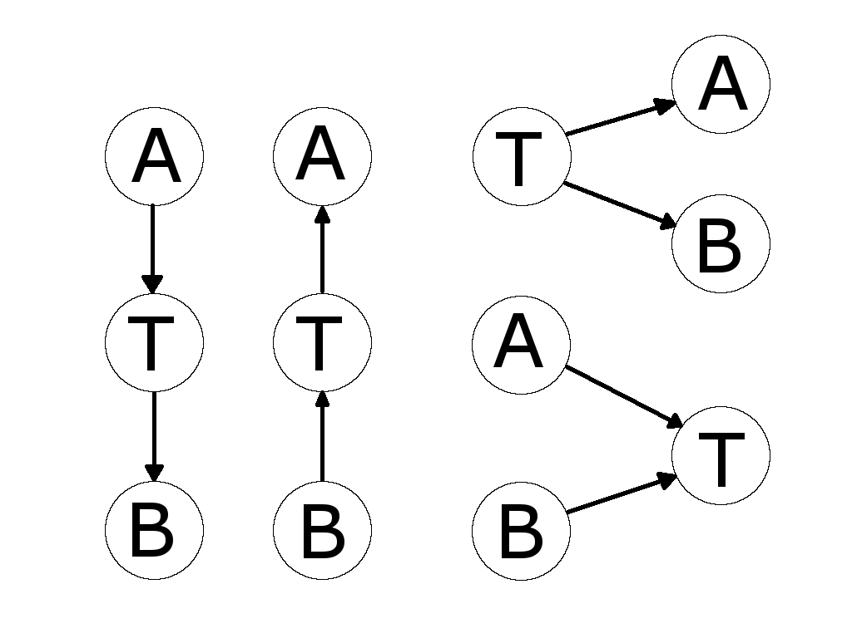
Conflict Grouping
Introduction ◌◌◌◌ | State Space ◌◌◌ | State Variables ◌◌◌●◌◌◌◌ | Problems ◌◌
Given that C is in conflict with both A and B
A and B are grouped if
Haystack: A Compiler for CHP | Ned Bingham

Slide 16
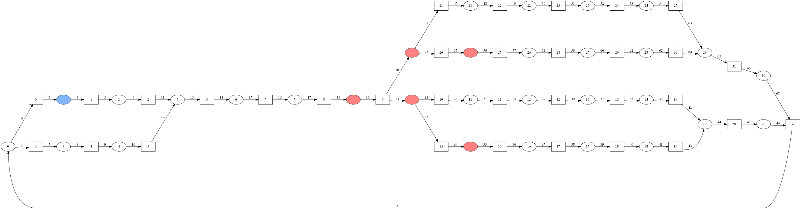
Generate Paths
Introduction ◌◌◌◌ | State Space ◌◌◌ | State Variables ◌◌◌◌●◌◌◌ | Problems ◌◌
Haystack: A Compiler for CHP | Ned Bingham

Slide 17
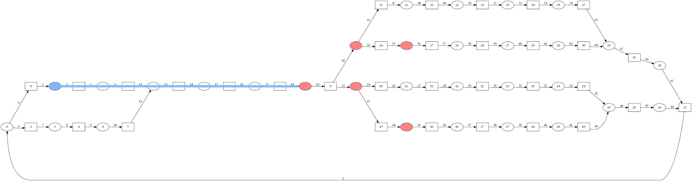
Generate Paths
Introduction ◌◌◌◌ | State Space ◌◌◌ | State Variables ◌◌◌◌●◌◌◌ | Problems ◌◌
Haystack: A Compiler for CHP | Ned Bingham

Slide 18
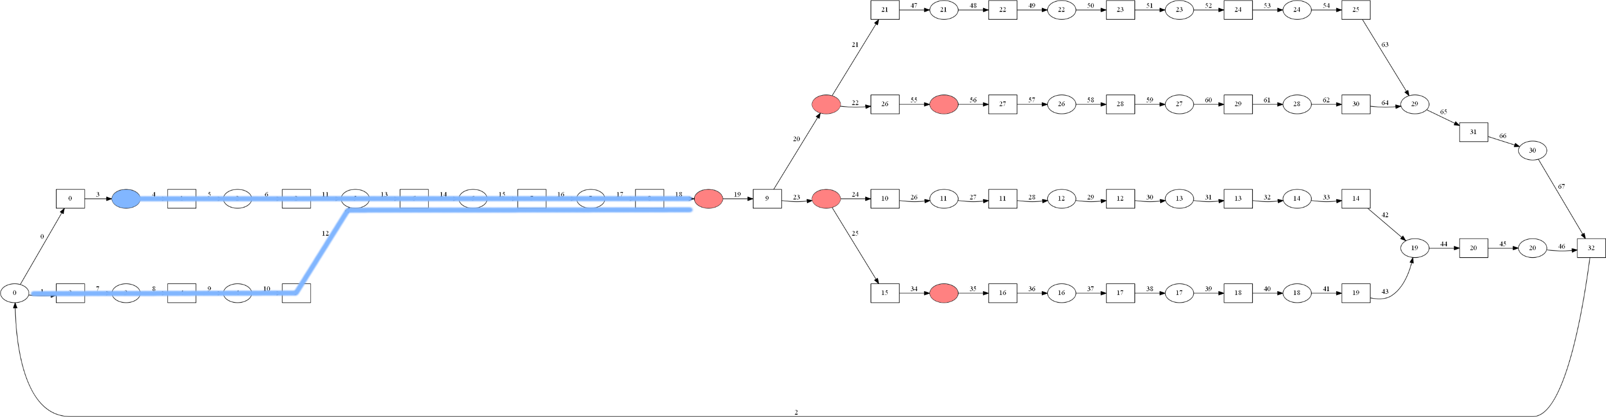
Generate Paths
Introduction ◌◌◌◌ | State Space ◌◌◌ | State Variables ◌◌◌◌●◌◌◌ | Problems ◌◌
Haystack: A Compiler for CHP | Ned Bingham

Slide 19
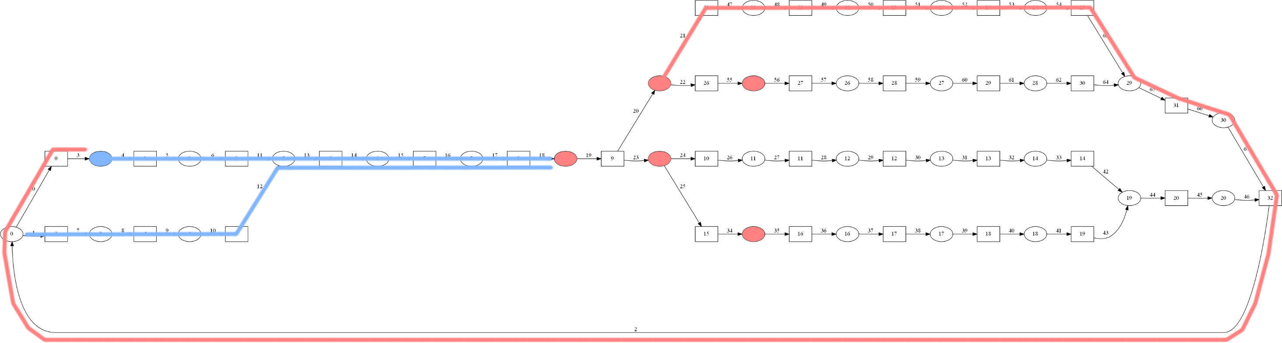
Generate Paths
Introduction ◌◌◌◌ | State Space ◌◌◌ | State Variables ◌◌◌◌●◌◌◌ | Problems ◌◌
Haystack: A Compiler for CHP | Ned Bingham

Slide 20
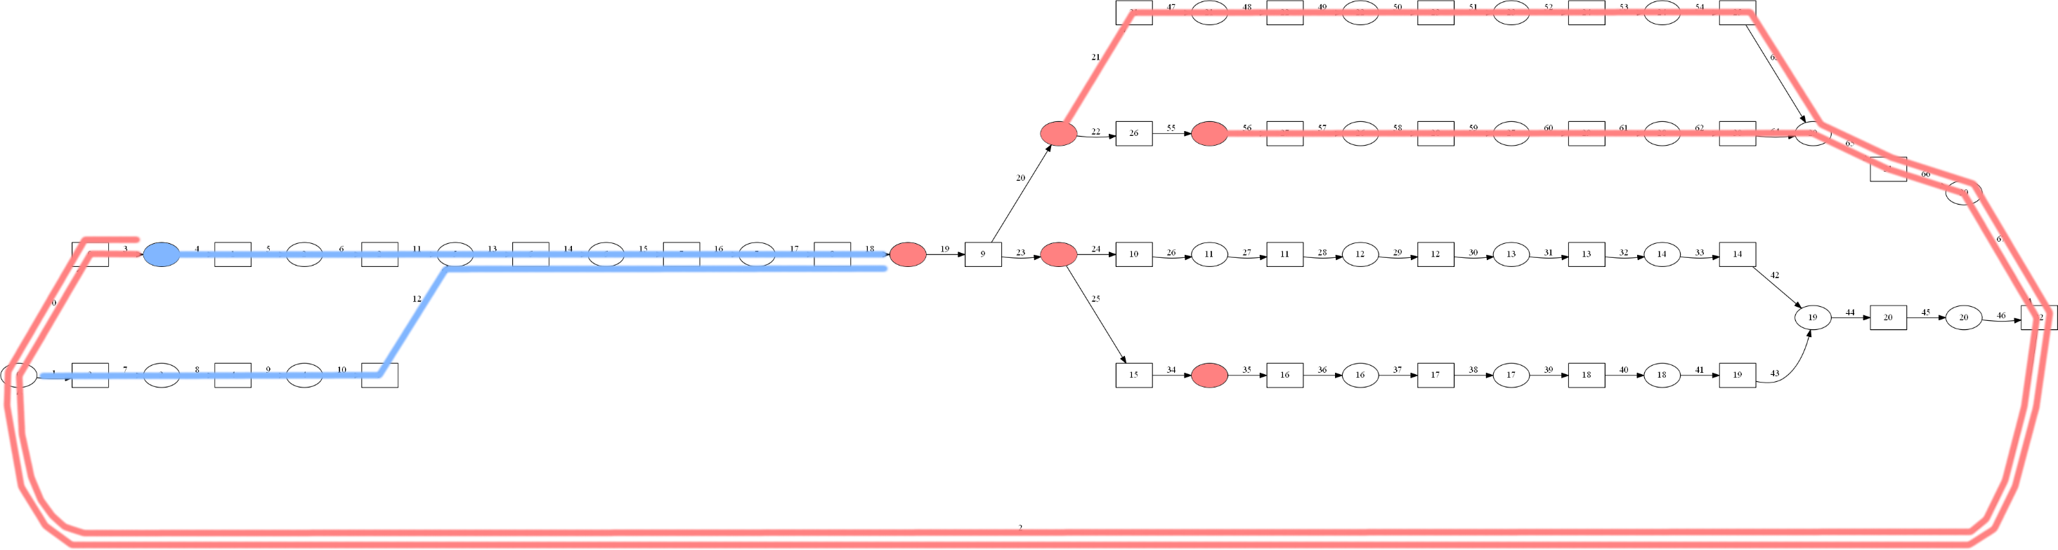
Generate Paths
Introduction ◌◌◌◌ | State Space ◌◌◌ | State Variables ◌◌◌◌●◌◌◌ | Problems ◌◌
Haystack: A Compiler for CHP | Ned Bingham

Slide 21
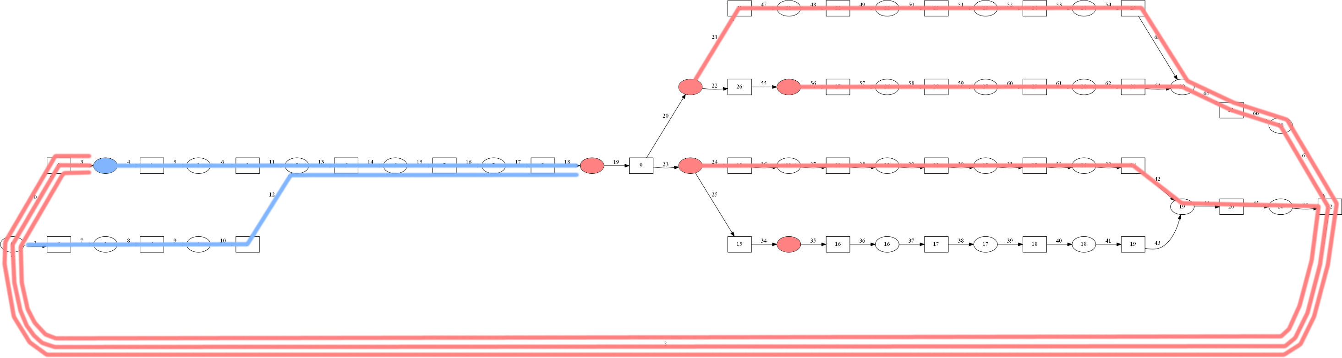
Generate Paths
Introduction ◌◌◌◌ | State Space ◌◌◌ | State Variables ◌◌◌◌●◌◌◌ | Problems ◌◌
Haystack: A Compiler for CHP | Ned Bingham

Slide 22
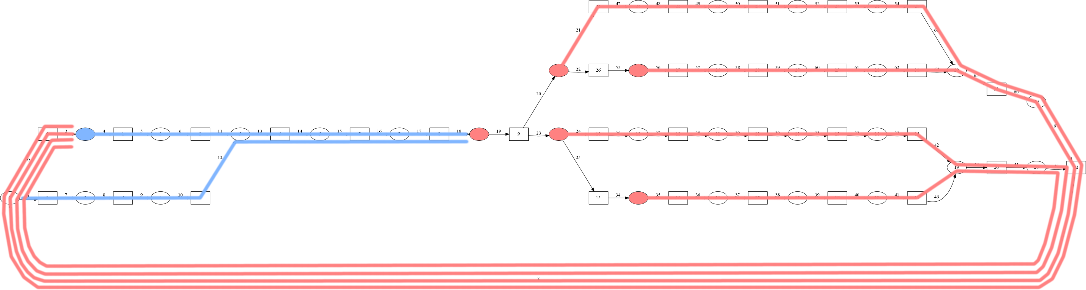
Generate Paths
Introduction ◌◌◌◌ | State Space ◌◌◌ | State Variables ◌◌◌◌●◌◌◌ | Problems ◌◌
Haystack: A Compiler for CHP | Ned Bingham

Slide 23
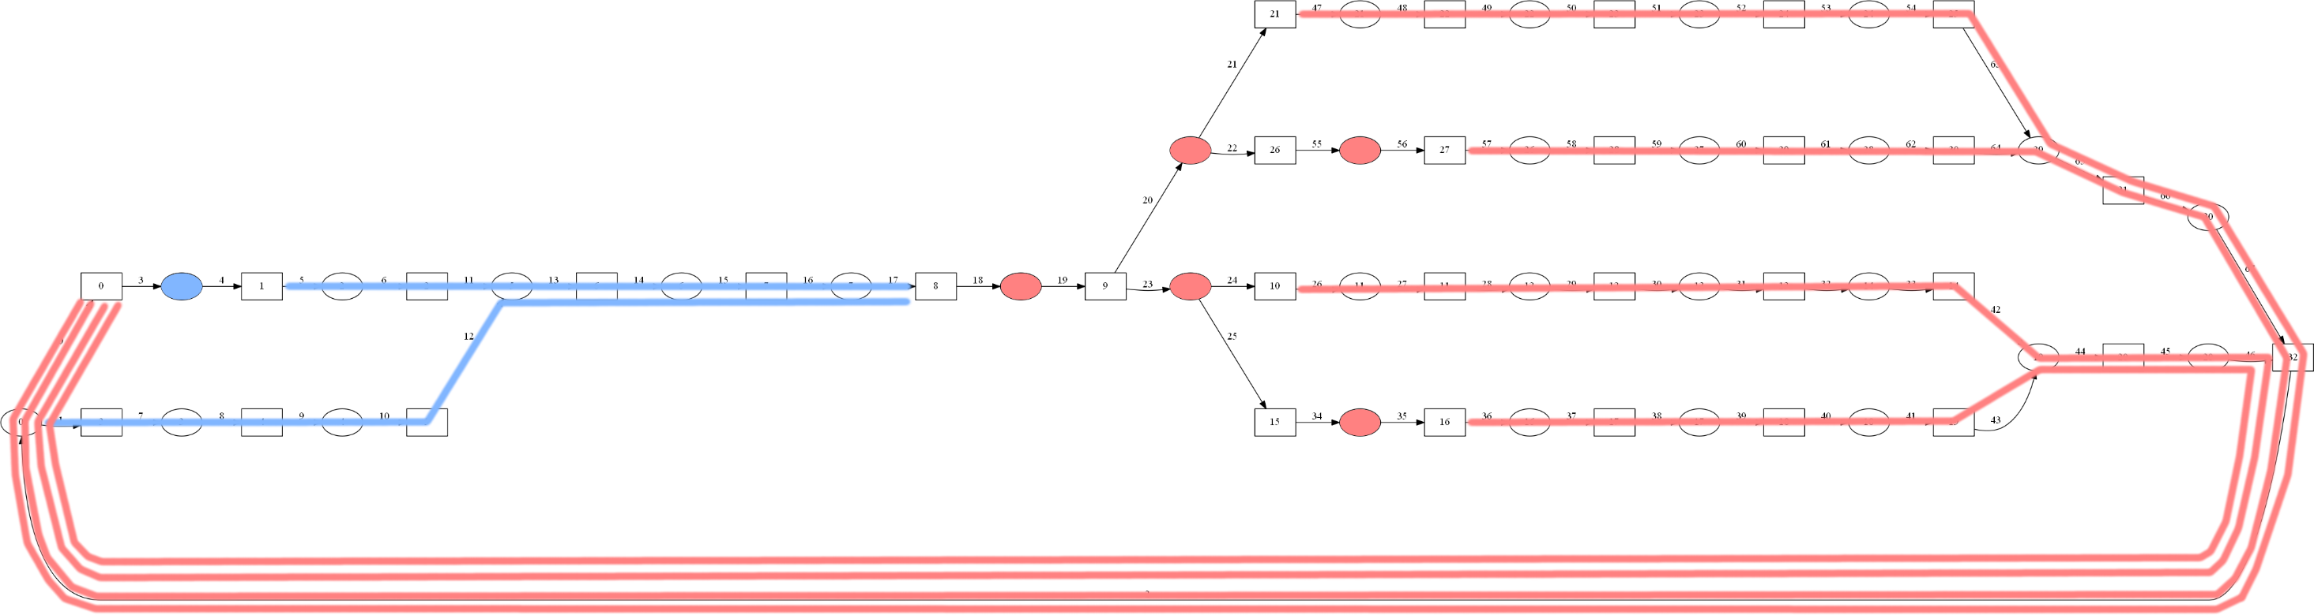
Trim Paths
Introduction ◌◌◌◌ | State Space ◌◌◌ | State Variables ◌◌◌◌◌●◌◌ | Problems ◌◌
Haystack: A Compiler for CHP | Ned Bingham

Slide 24
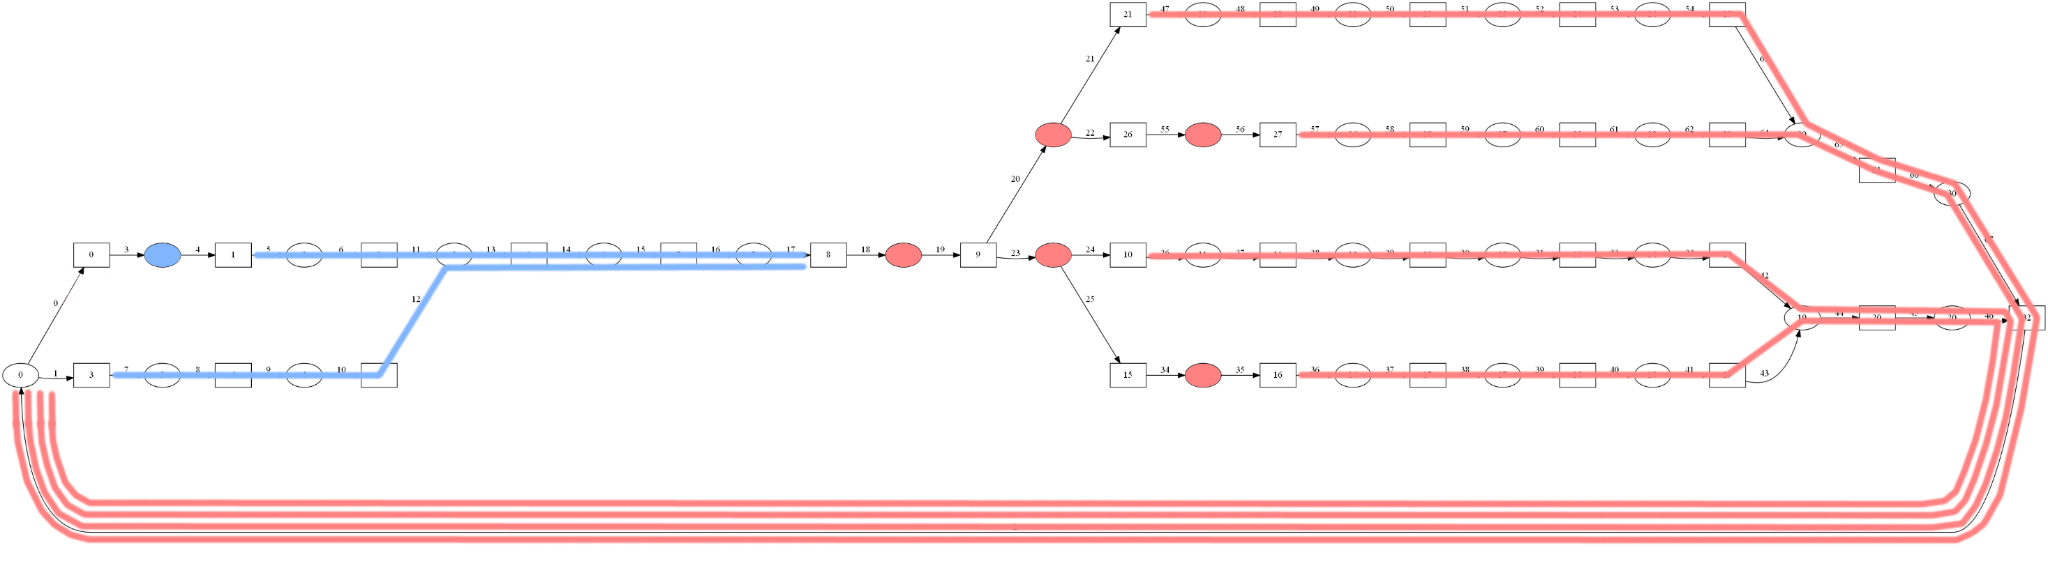
Trim Paths
Introduction ◌◌◌◌ | State Space ◌◌◌ | State Variables ◌◌◌◌◌●◌◌ | Problems ◌◌
Haystack: A Compiler for CHP | Ned Bingham

Slide 25
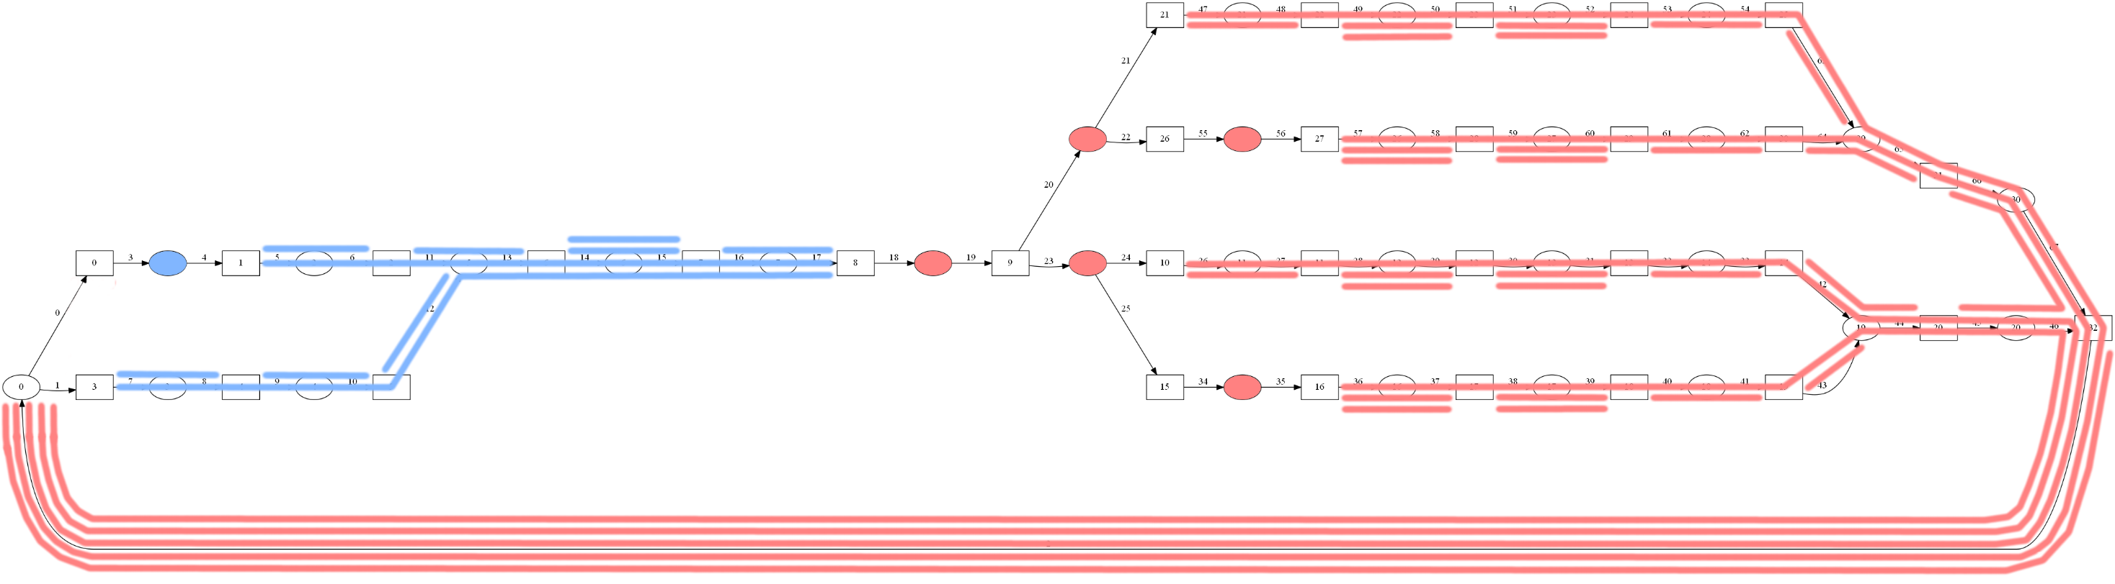
Consider Indistinguishables
Introduction ◌◌◌◌ | State Space ◌◌◌ | State Variables ◌◌◌◌◌◌●◌ | Problems ◌◌
Haystack: A Compiler for CHP | Ned Bingham

Slide 26
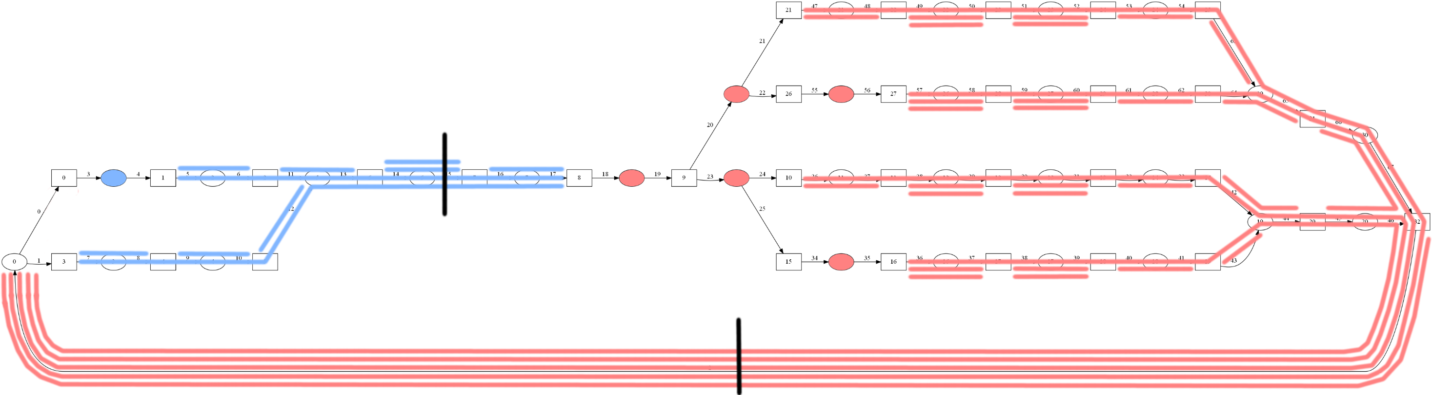
Place State Variable Transitions
Introduction ◌◌◌◌ | State Space ◌◌◌ | State Variables ◌◌◌◌◌◌◌● | Problems ◌◌
Haystack: A Compiler for CHP | Ned Bingham

Slide 27
Unsolved Problems
Introduction ◌◌◌◌ | State Space ◌◌◌ | State Variables ◌◌◌◌◌◌◌◌ | Problems ●◌
Handshaking Reshuffling
2 Phase CHP difficult to derive from HSE and clumsy to enforce in syntax
What determines a “legal” move is ambiguous
How that move affects conflicting states is ambiguous
Most likely will be approached from the state space level
Bubble Reshuffling
Direct Method requires modification of state variable insertion algorithm
Indirect Method not always solvable
Haystack: A Compiler for CHP | Ned Bingham

Slide 28
Unsolved Problems
Introduction ◌◌◌◌ | State Space ◌◌◌ | State Variables ◌◌◌◌◌◌◌◌ | Problems ◌●
Conflict Grouping: Better method?
State Variable Insertion: Better method for considering indistinguishables?
Overall: Am I missing anything?
Haystack: A Compiler for CHP | Ned Bingham

